Slide 1
Communicating with Adolescents
Name
ABS 497 Applied Behavioral Science Capstone

Slide 2
Why is social skills training important?
Social skills training is important for adolescents to learn effective communication skills between their peers as well as society.

Slide 3
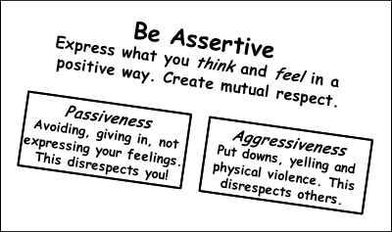
Be Positive

Slide 4
Examples of Communication
Nonassertive
  When an individual believes that their perspective is less important than others.
Assertive
  When an individual is taking others opinions in consideration along with theirs.
Aggressive
  When an individual only thinks about themselves and do not value others opinions.

Slide 5
Four Strategies
Non-verbal communication
Awareness
Taking Responsibility
Become an active listener

Slide 6

Communication Around the World

Slide 7
Hypothetical Scenarios
1. Scenario
    Every time Sally is with friends they use hurtful words such as retarded, stupid, and ugly. It begins to make her feel uncomfortable.
Solving
    Sally could let them know how she feels, and she could ask them to stop calling her names.
2. Scenario
    David was at a football game and another kid was trying to start a fight with him because he had the most attention from the girls.
Solving
    He could easily walk away using non verbal communication with the other kid. Ignore the situation and walk away.
3. Scenario
    After cheerleading practice, the girls decided to ignore the new girl on the team because they felt that she didn’t fit in with the group because her culture was different than theirs.
Solving
    They could take the time to get to know her versus judging her by her culture. She could try to show that she has the same interest as they do more than just cheering, and she could break the ice by showing a new cheer to start a positive conversation.

Slide 8
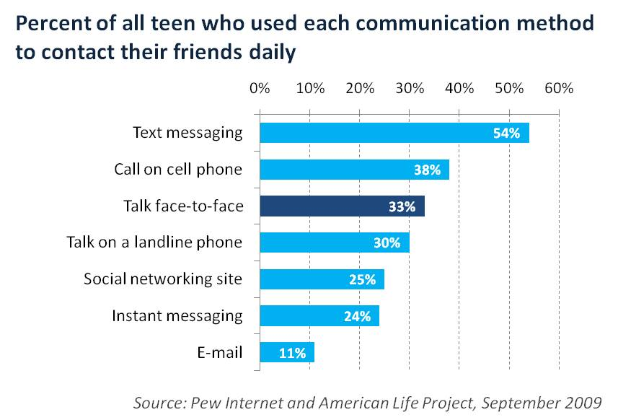
Adolescents Using Communication in Different Ways.

Slide 9
Conclusion
Based off the 4 strategies that were taught in the training lesson, the adolescents will discover what type of individual they are (assertive, non-assertive, and aggressive). If the adolescent is non-assertive or aggressive, they will learn effective skills to become more balanced in communication.

Slide 10
References:
Chien-Ti, L., Beckert, T. E., & Goodrich, T. R. (2010). The relationship between individualistic, collectivistic, and transitional cultural value orientations and adolescents’ autonomy and identity status. Journal of Youth & Adolescence, 39(8), 882-893. Retrieved from the ProQuest database.
Jorgensen, G. (2006). Kohlberg and Gilligan: Duet or duel? Journal of Moral Education, 35(2), 179-196. Retrieved from the EBSCOhost database.
Zastrow, C. H. & Kirst-Ashman, K. K. (2010). Understanding human behavior and the social environment (9th ed.). Mason, OH: Cengage.
Kaiser, B. (2006). Social Skills. Retrieved October 22, 2012, from http://www.education.com/reference/article/social-skills/

